Slide 1

Trending-video history on YouTube
Analyze content for the advertising agency
By Maryna Tetelbaum

Slide 2
Content
The goal of the project
Trending history
Trending history, %
Trending videos split by country
Trending videos split by categories on region United States
Trending by country and category
Conclusion
Schema of the dashboard

Slide 3
Summary
In this project we analyzed data on trending video history on You Tube.
Based on the analyzes, Trend History graph was built (number of videos is presented in the form of a graph of the number of videos broken down by dates), as well as Trending Video by Region chart.
A highlight table Trending Vids by Region and Category presents data on the number of trending videos by region and category. Based on the analysis, a dashboard was developed, the link is provided below in the description.

Slide 4
The goal of the project
The main goal of the project is to analyze and present current data on trending video history on You Tube.
The dashboard will be the most visual and convenient for use (the link is attached at the end of the project), where it is possible to filter data by date and country.

Slide 5
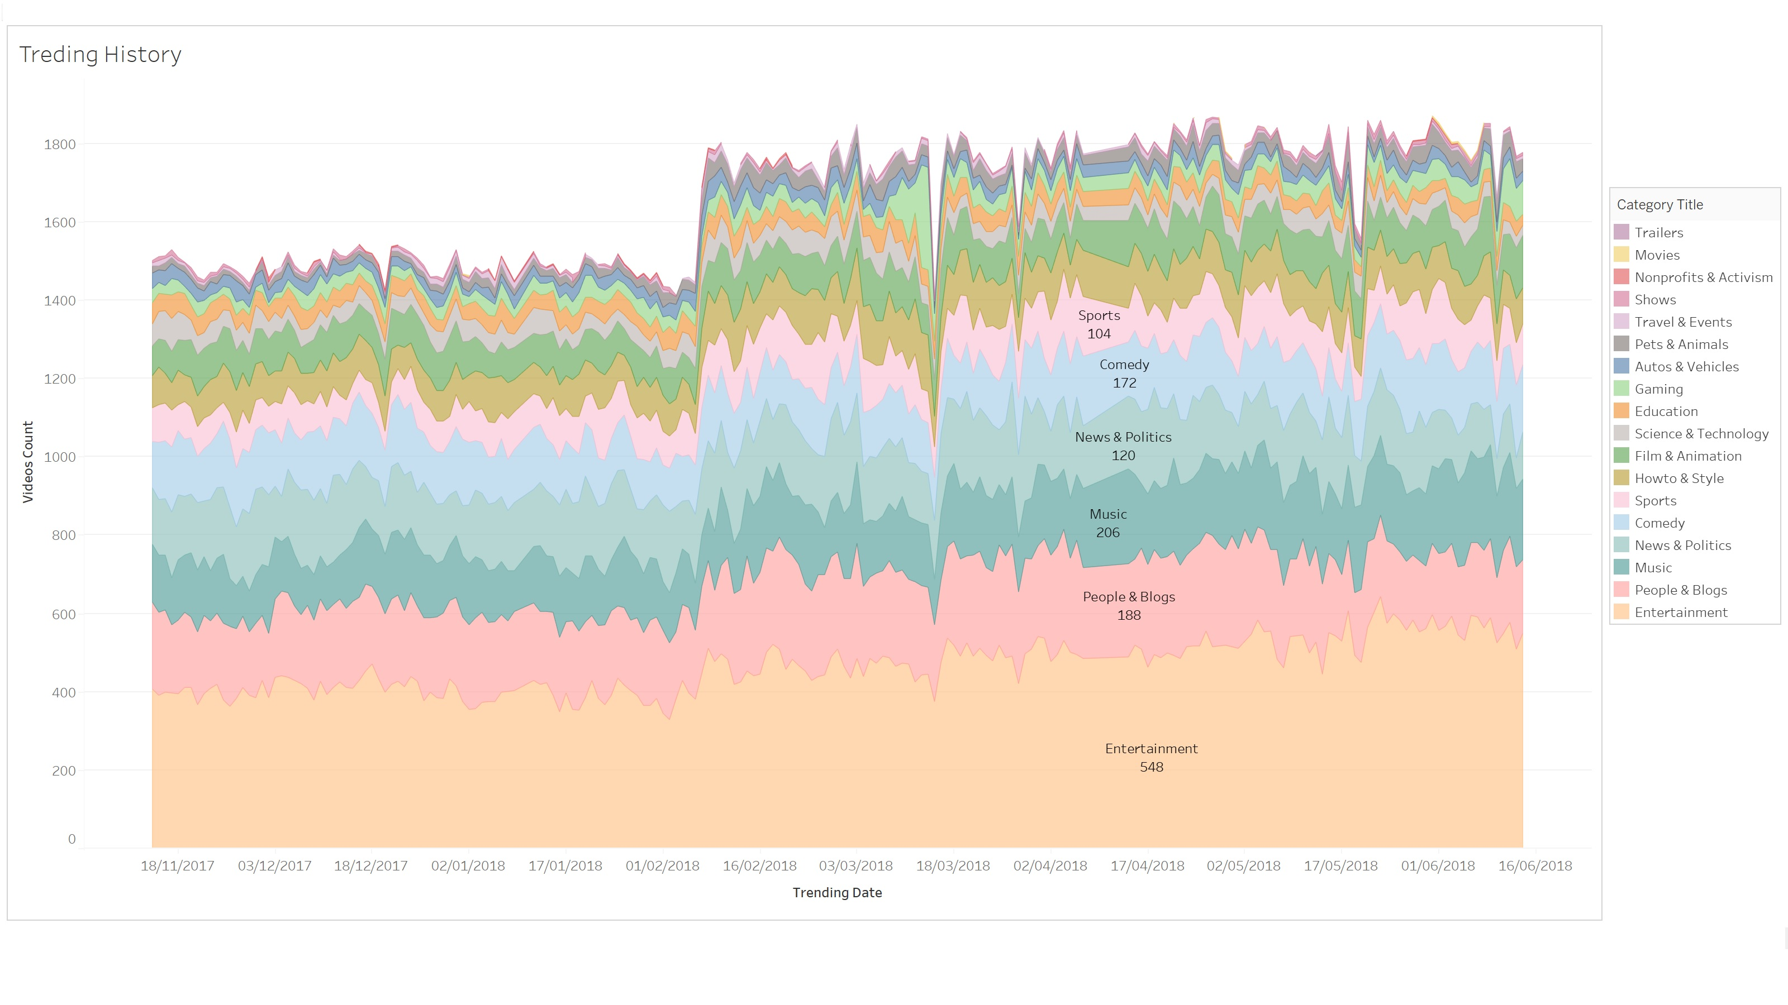
The graph shows us the changes in the number of trending vids broken down by categories in absolute terms. We can draw some conclusions from this graph: 1. In February 2018 there was a sharp jump in the number of trending videos, and during the same year we see short-term but sharp drops (which is most likely due to some technical reasons) 2. Throughout the analyze period the category of entertainment was the most popular among users and its popularity is growing every day.
The graph shows us the changes in the number of trending vids broken down by categories in absolute terms. We can draw some conclusions from this graph: 1. In February 2018 there was a sharp jump in the number of trending videos, and during the same year we see short-term but sharp drops (which is most likely due to some technical reasons) 2. Throughout the analyze period the category of entertainment was the most popular among users and its popularity is growing every day.

Slide 6
The graph shows us the changes in the number of trending vids broken down by categories in absolute terms. We can draw some conclusions from the graph: - In February 2018 there was a sharp jump in the number of trending videos, and during the same year we see short-term but sharp drops (which is most likely due to some technical reasons) - Throughout the analyze period the category of entertainment was the most popular among users and its popularity is growing every day.

Slide 7
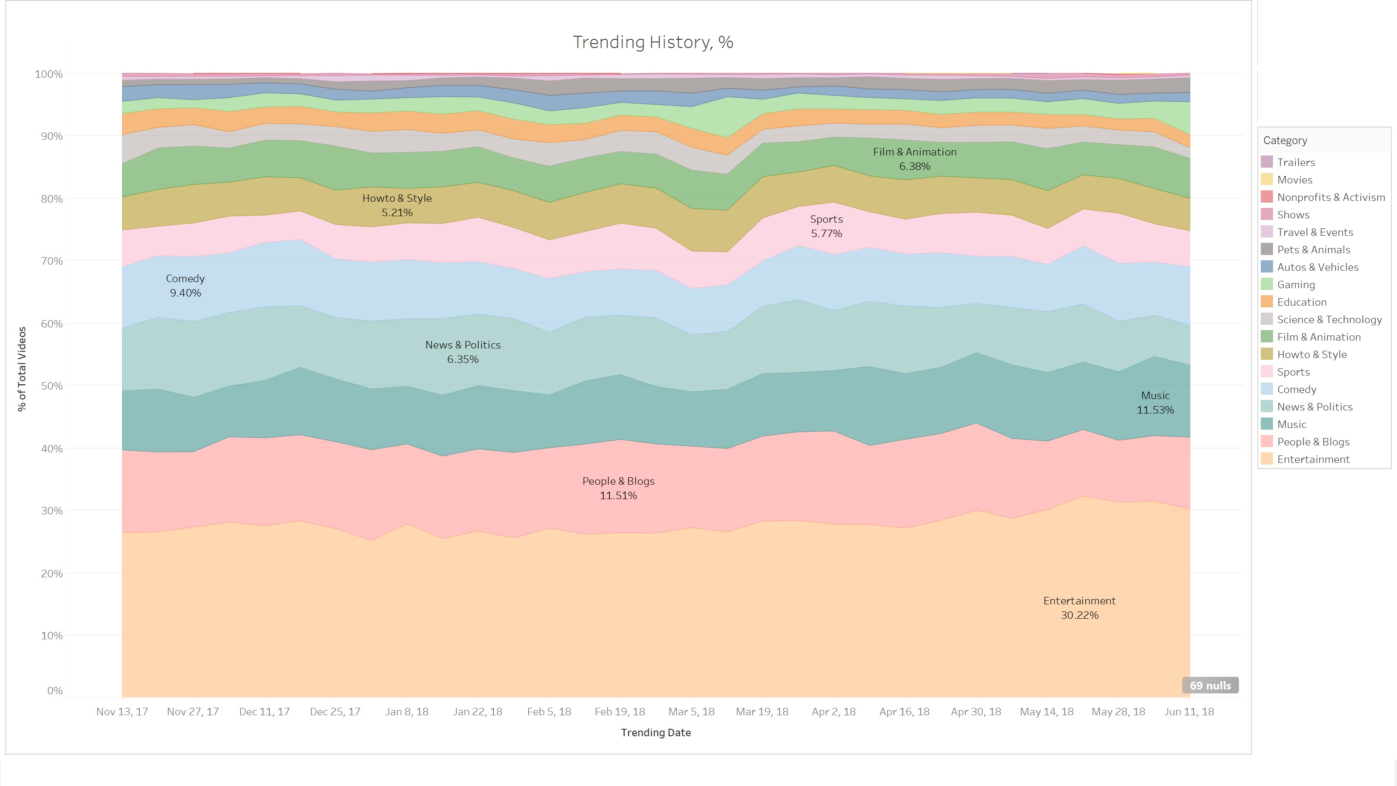
On this graph we can clearly see that the most trending YouTube video category is the Entertainment category (30 % from all trending categories). Categories are less popular are People & Blogs and Music (11 % from all trending categories).

Slide 8
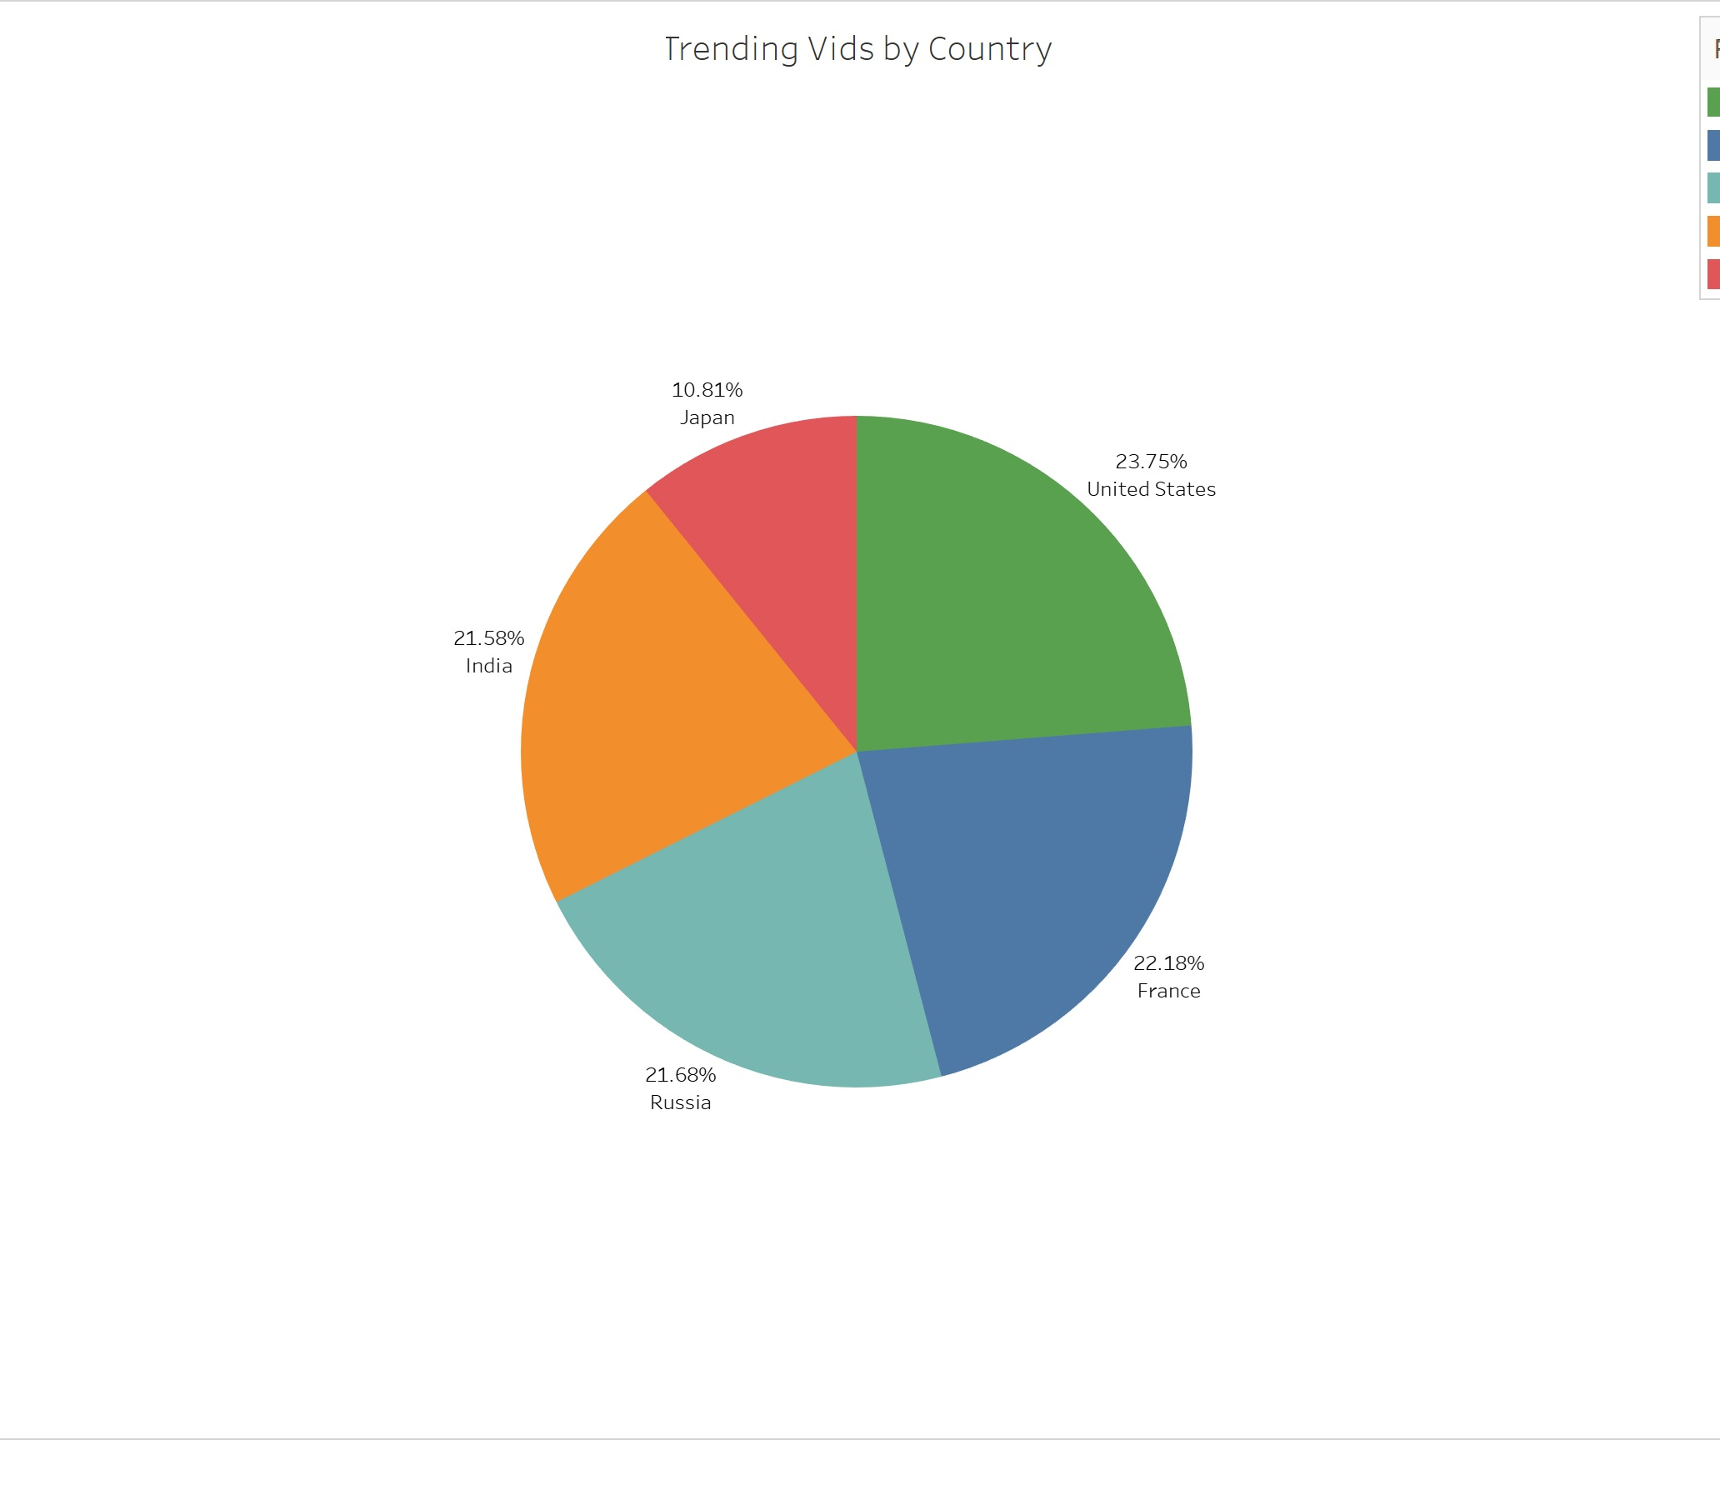
Trending videos split by country
The graph shows the distribution of the number of all trending videos by region.
The largest part of trending videos is represented by the United States (24%).
The regions France, Russia and India are practically at the same level with US.
The smallest number of trending videos is in the Japan region (11 %).

Slide 9
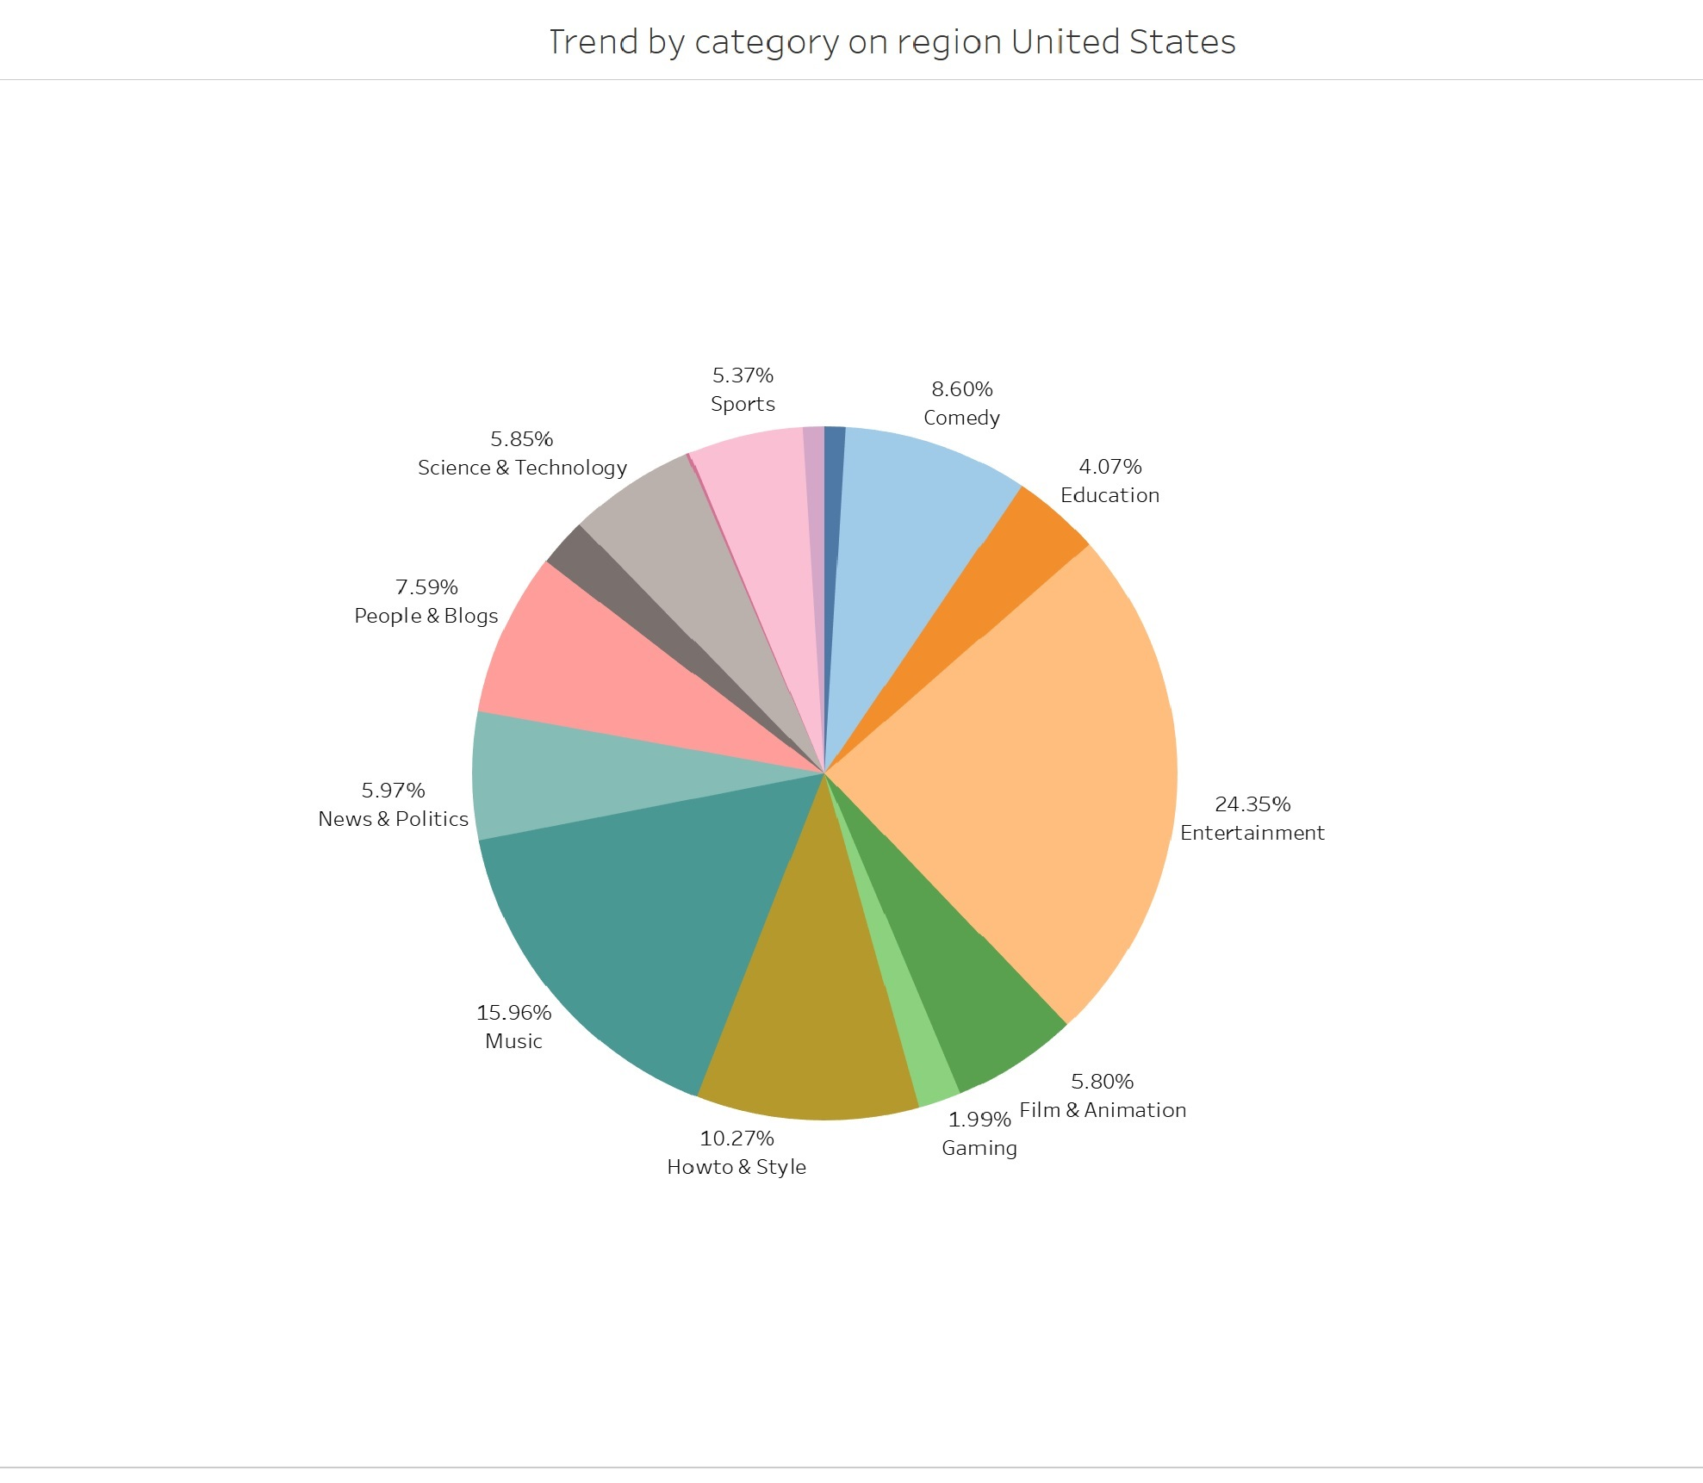
Trending videos split by categories on region United States
What categories were especially popular in the United States?
The most popular category in the US is Entertainment (24%).
Additional popular categories are Music (16%), Howto & Style (10%), People & Blogs and Comedy (8 % each).

Slide 10
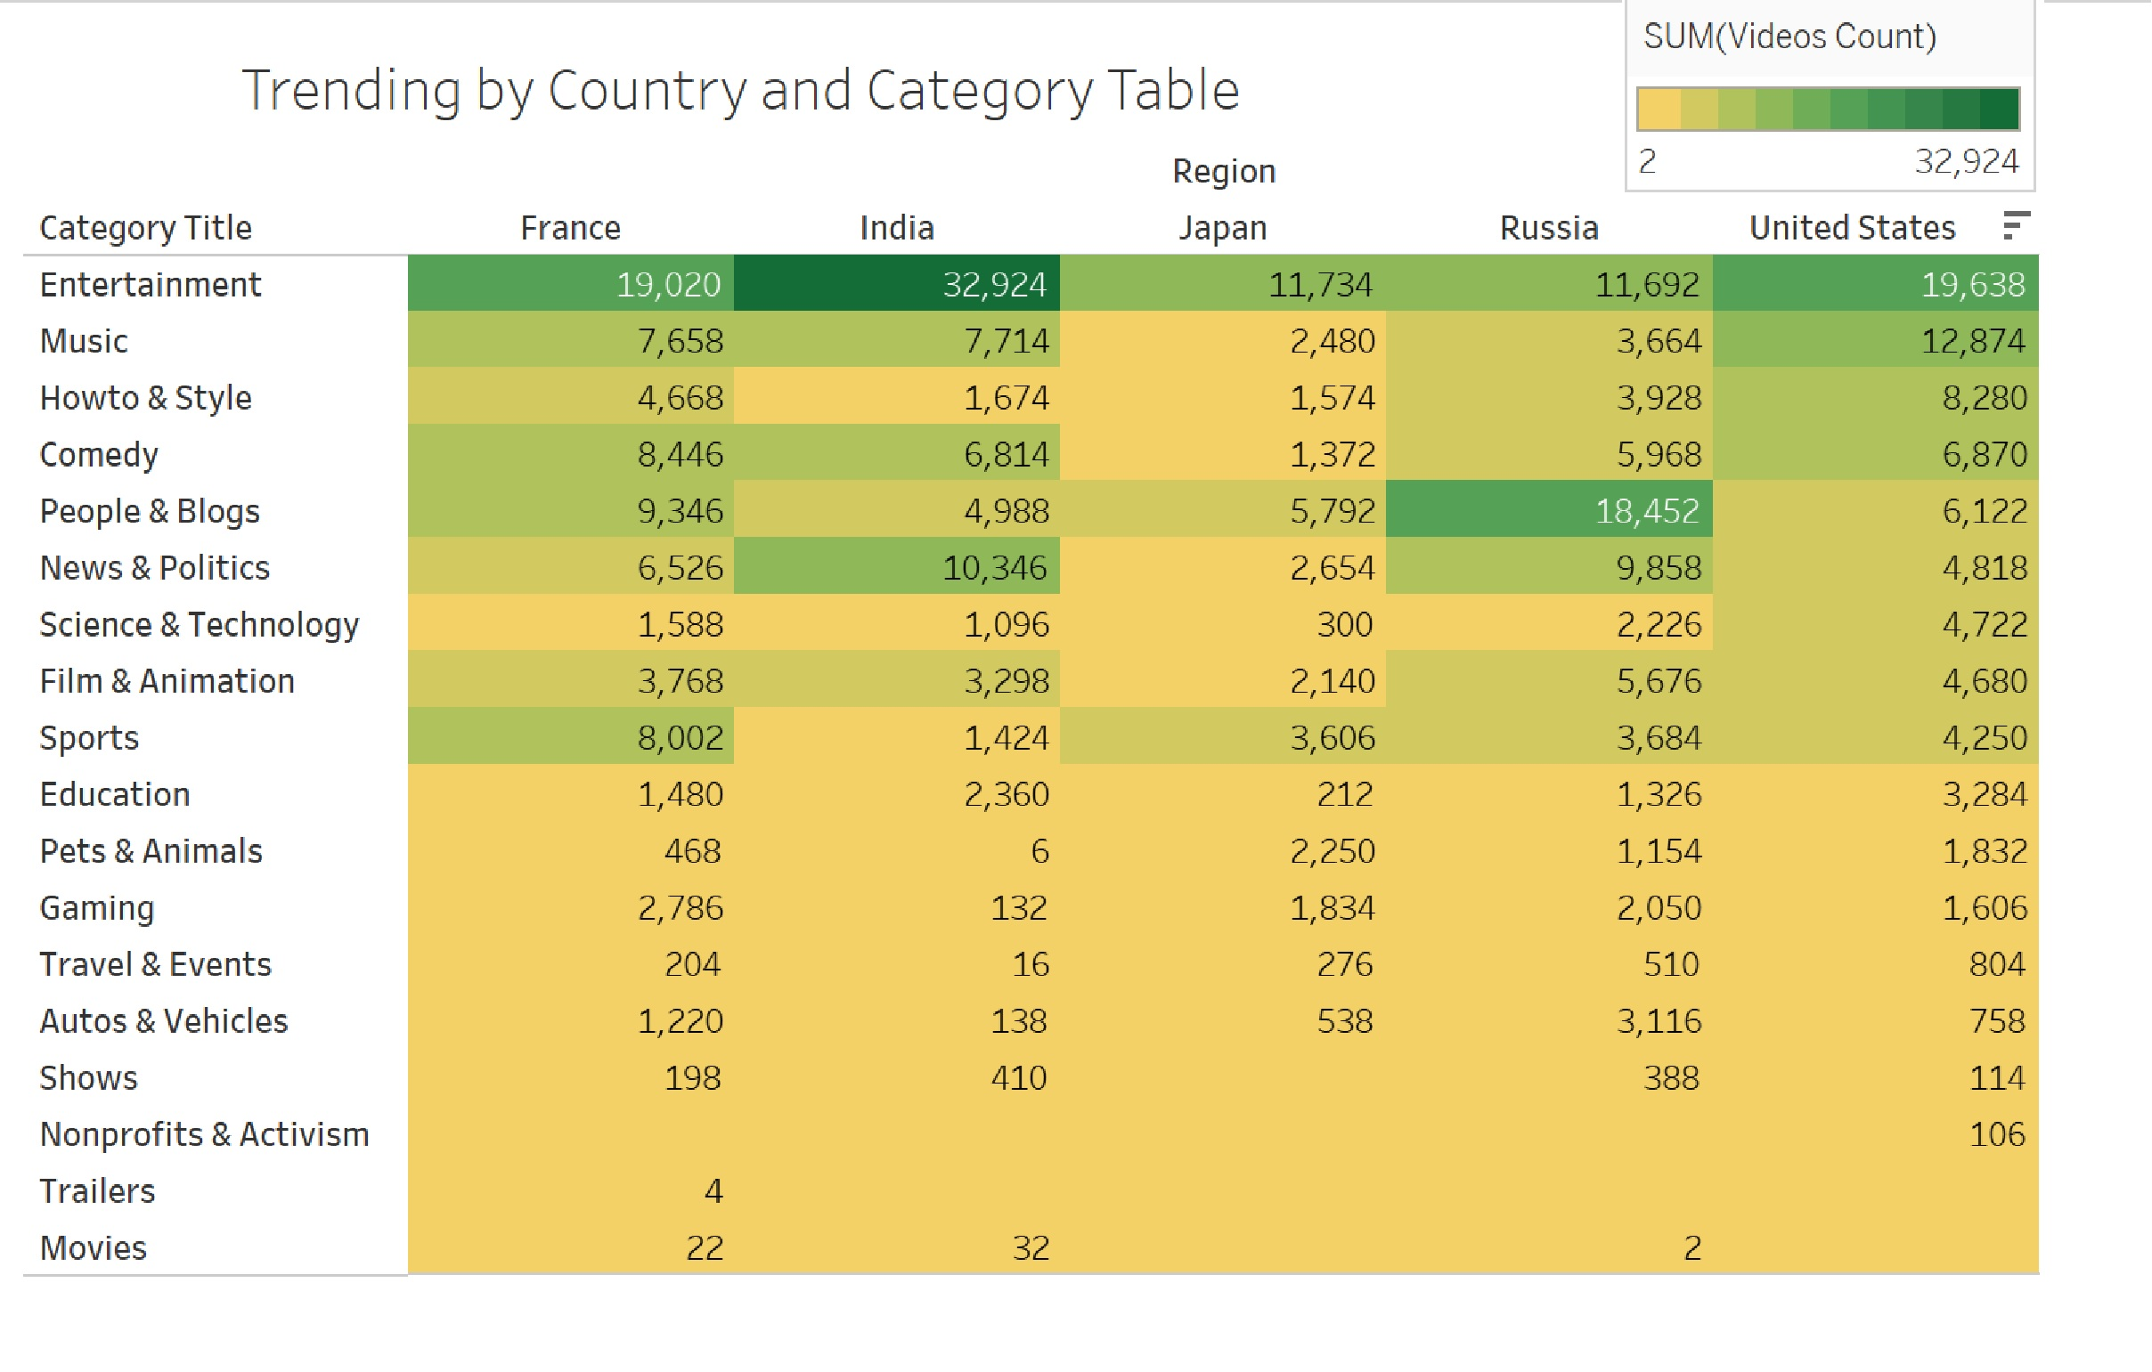
The table shows the absolute values of trending videos split by category and region
The table is presented in the form of a highlight table for a more convenient definition of preferences in categories for each region.
There are certain differences in the preferences of users of each region. For example, the Science category is popular in the US, but it is not so popular in other regions. Or the Nonprofits category with a small number of trend videos is absolutely not popular in other regions.
Each region has its own characteristics, I suppose that it is due to the mentality of the inhabitants of a certain region and also the political situation, and their preferences are based on this.

Slide 11
Conclusion
In conclusion, I want to emphasize that we have completed all the tasks set for us and presented them in the format necessary for further work.
Link to the Main Dashboard:
https://public.tableau.com/app/profile/maryna2963/viz/Trending-videohistoryonYouTubeDashboard/Trending-videosonYouTube
Link to an additional Dashboard for a more detailed analysis of data broken down by countries and categories
https://public.tableau.com/app/profile/maryna2963/viz/Trendssplitbycountryandcategory/TrendssplitbyCountryandCategoryDashboard

Slide 12
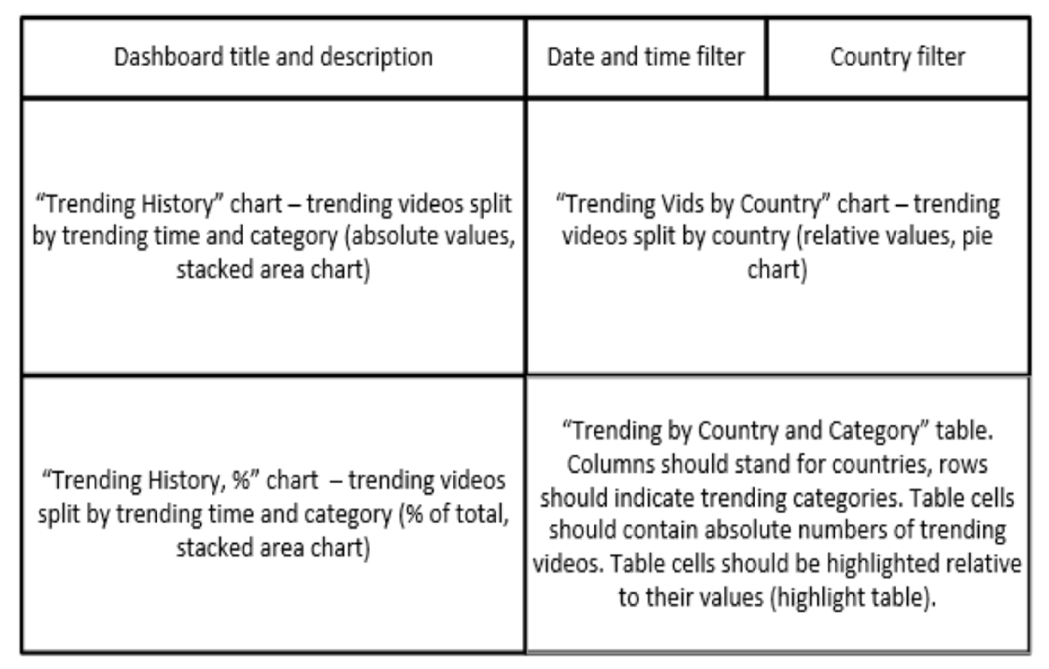
Schema of the dashboard

